Slide 1
CSCI 4370 Project 5
By: Jey, Justin, Narita, Phillip, and Ryan

Slide 2
Project Overview
Database holding information for a company’s rewards program
Real world application
Widely used system
Our version
For buying shoes
Users put into tiers based on number of points
Higher tiers have more discounts given
Points reset every quarter, when the “coupons” are sent out
Java Server Pages (JSP)
Allows communication between database and website via servlets

Slide 3
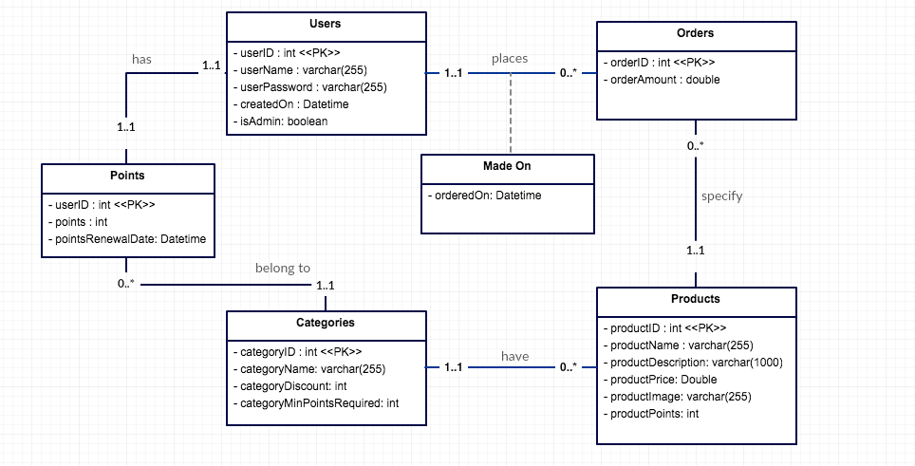
UML Diagram

Slide 4
Convert UML to Relational Model (ρ₁)
Users(userID, isAdmin, userName, userPassword, createdOn)
Points(userID, points, userCategoryID, pointsRenewalDate)
Categories(categoryID, categoryName, categoryDiscount, categoryMinPoints)
Products(productID, productPrice, productImage, ProductName, productDescription, productPoints, productCategoryID)
Orders(orderID, userID, productID, orderAmount)

Slide 5
1NF
Labels | DBMS Project 5
A | userId
B | isAdmin
C | userName
D | userPassword
E | userCreatedOn
F | orderId
G | orderedOn
H | amount
I | productId
J | productPrice
K | productImage
L | productName
M | productDescription
N | productPoints
O | categoryId
P | categoryName
Q | categoryDiscount
R | categoryMinPoints
S | points
T | pointsRenewalDate

Slide 6
Functional Dependencies
O→PQR
I→JKLMNO
A→BCDESTO
C→A
F→AGHI

Slide 7
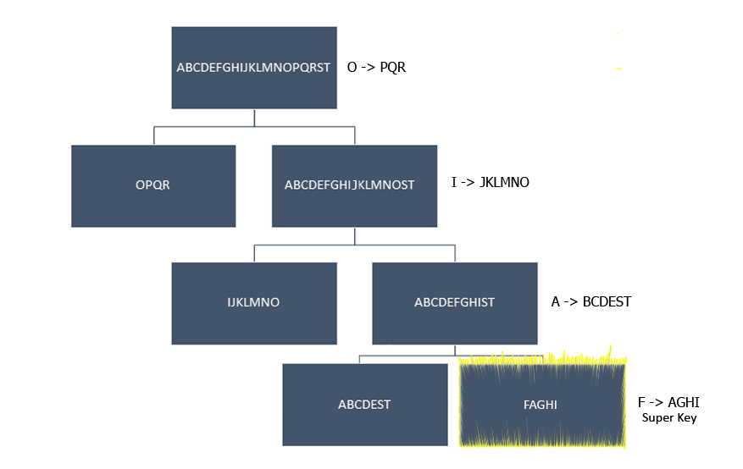
BCNF Decomposition Algorithm (ρ₂)

Slide 8
BCNF Tables
Categories
categoryId <<PK>> categoryName categoryDiscount categoryMinPoints
Products
productId <<PK>> productPrice productImage productName productDescription productPoints categoryId
Users
userId <<PK>> isAdmin userName userPassword userCreatedOn points pointsRenewal
Orders
orderId <<PK>> userId orderedOn amount productId

Slide 9
3NF Decomposition Algorithm (ρ₃)
Functional dependencies → functional dependencies minimal form
Create a table for each functional dependency
Check if lossless

Slide 10
FD → FD_{m}
O→PQR
I→JKLMNO
A→BCDESTO
C→A
F→AGHI
These functional dependencies are already in minimal cover

Slide 11
Create Tables
Categories
categoryId <<PK>> categoryName categoryDiscount categoryMinPoints
Products
productId <<PK>> productPrice productImage productName productDescription productPoints productCategoryId
Users
userId <<PK>> isAdmin userName userPassword userCreatedOn points pointsRenewal categoryId
Orders
orderId <<PK>> userId orderedOn amount prodId
username->userID
userName <<PK>> userId

Slide 12
Check if Lossless
Get rid of (username->userID) table because it is a subset of the users table
Categories
categoryId <<PK>> categoryName categoryDiscount categoryMinPoints
Products
productId <<PK>> productPrice productImage productName productDescription productPoints productCategoryId
Users
userId <<PK>> isAdmin userName userPassword userCreatedOn points pointsRenewal categoryId
Orders
orderId <<PK>> userId orderedOn amount prodId

Slide 13
ρ₁, ρ₂, ρ₃ Comparison
UML contains 5 tables
BCNF contains 4 tables
3NF contains 4 tables
BCNF and 3NF basically are the same except the users table in 3NF contains the categoryId
In BCNF, to get the categoryId for the users there needs to be a join where it checks if the user’s points has the minimum number of points to be in a certain category
The main difference between the UML and BCNF and 3NF is UML has the points table which contains points, pointsRenewalDate, and categoryId
This way the points table will keep on being updated instead of the users table being updated every time
Vertical fragmentation
For the project, we used the UML implementation

Slide 14
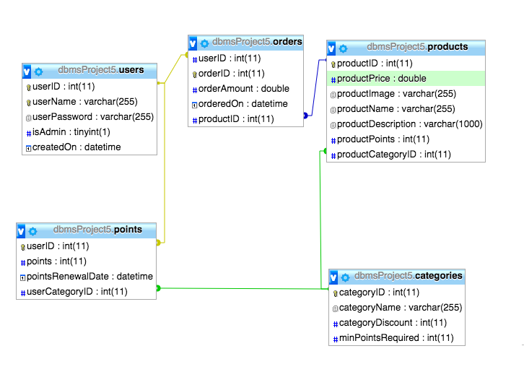
Schema

Slide 15
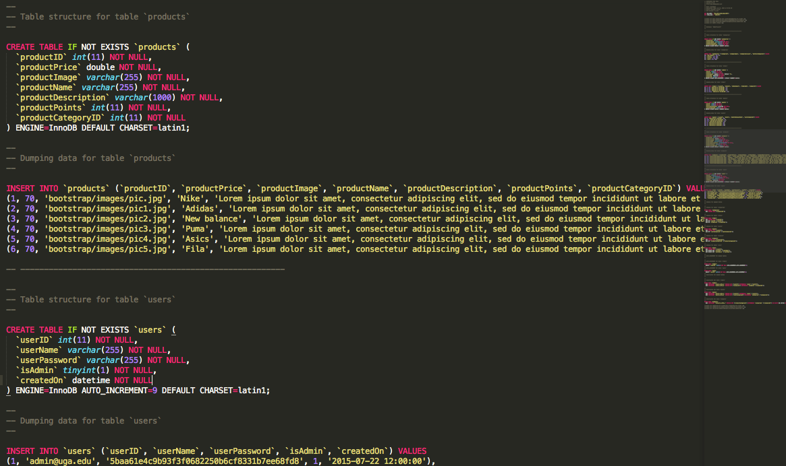
Inserts

Slide 16
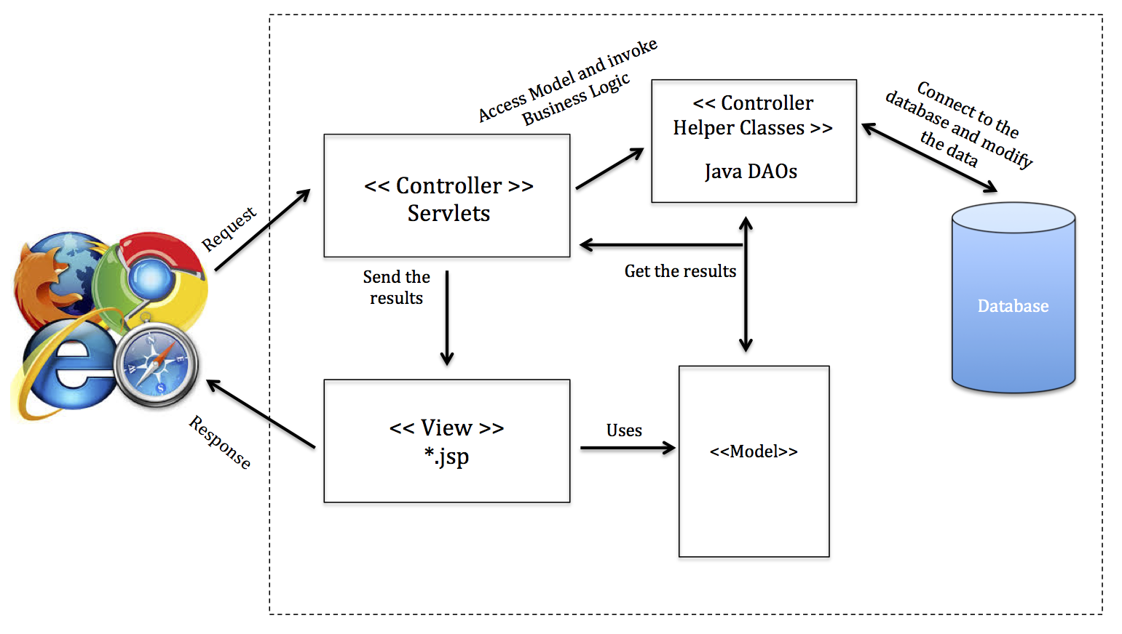
Architecture and Components

Slide 17
Demo time

Slide 18
Questions?

